Slide 1
CNN Medical Image Classification of Chest opacities
Brian Joram Wandobire
2100702314
2021/HD05/2314U

Slide 2
Problem Statement
Diagnosis of chest opacities is a challenge
Need for a deep learning model that can cut down on costs from alternative expensive and time consuming approaches
Solution: build a deep learning CNN model trained to predict image class

Slide 3
METHODOLOGY

Slide 4
Tools and Precautions
Google Colab, Tensor flow and Keras
Concern about reproducibility: Set the random seed and keras session at start

Slide 5
Data Exploration and Transformation
Dataset is split it into: Train Set Validation Set Text Set
Read new split dataset Starting with trainset – look out for imbalance Normal:254, Sick: 245

Slide 6
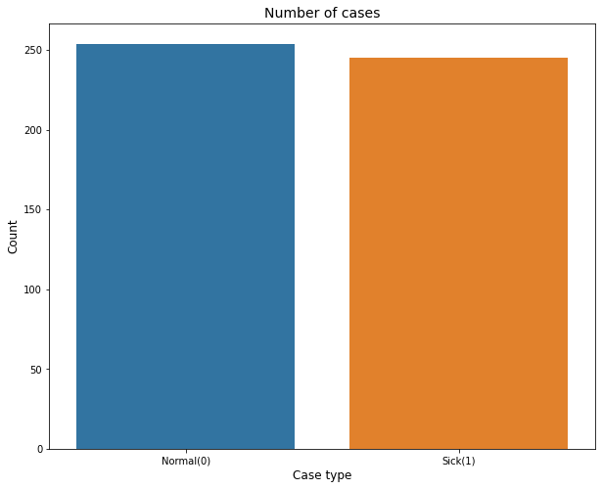
Dataset:

Slide 7
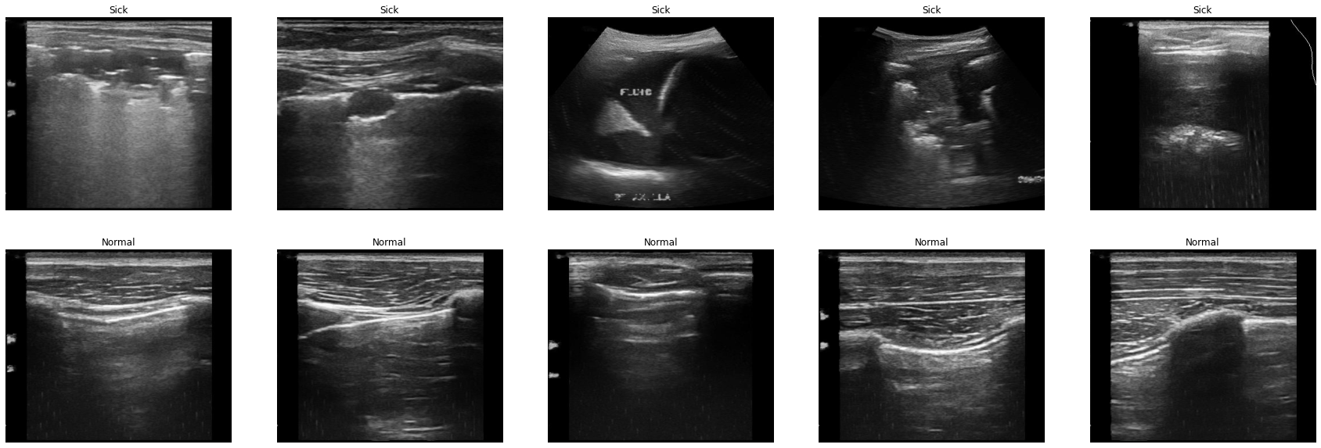
Normal and Sick Samples

Slide 8
Data Exploration and Transformation -2
Validation data
Images could either be in gray scale or colour(3 channels)
Grayscale: convert into 3 channels.
Resize images(224,224)
Convert the list into numpy arrays

Slide 9
Data Exploration and Transformation -2
Augmentation(Oneof)
helpful for imbalanced dataset
Horizontal scale change, rotation and brightness
Data generator:
steps = n//batch_size
one hot encoding
generate more samples for undersampled class

Slide 10
Our Model (Total params: 104,197,506 Trainable params: 104,194,434 Non-trainable params: 3,072) 25Layers

Slide 11
Selection-1
Transfer learning(Vgg16) + model training from scratch.
Initialize first few layers from a network (imagenet) and fine tune.
capture general details like patches , edges, etc.
Depth Separable Conv introduces lesser number of parameters as compared to normal convolution
batch norm with convolutions:
Important as the network goes deeper

Slide 12
Selection-2
Dense layers
higher learning rate and experiment with the number of neurons in the dense layers.
Initialize the weights of first two convolutions with imagenet weights

Slide 13
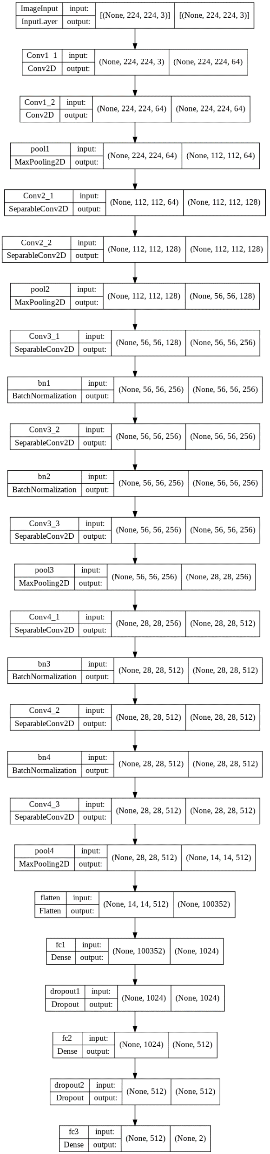
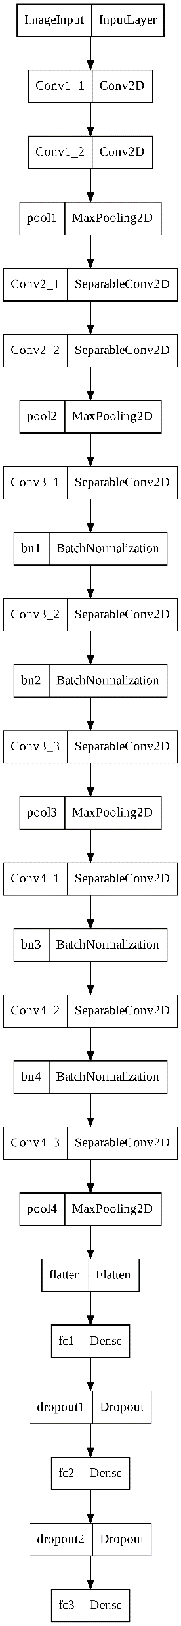

Slide 14
Selection-3
Adam(lr=0.0001, decay=1e-5):
EarlyStopping: (patience=5):
Loss: binary crossentropy
Metrics: accuracy
Batch Size = 4, epochs = 50
Train steps:
Number of training and validation steps: 122 and 106
Model fitting: Class Weights {0:1.0, 1:0.4}

Slide 15
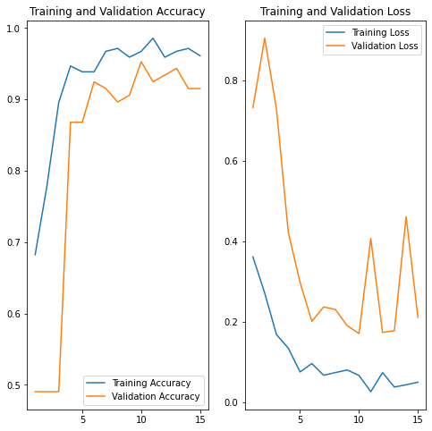
Metrics Visualisation Epoch 15/50- 12s 96ms/step - loss: 0.0493 - accuracy: 0.9611 - val_loss: 0.2105 - val_accuracy: 0.9151

Slide 16
Testing Model on Data

Slide 17
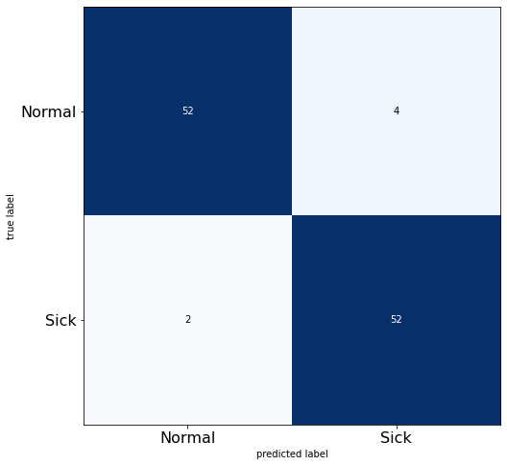
Unknown Dataset 1
Total number of test examples: 110
Input size: 224, 224
Color Channels: 3
Total number of labels: (110, 2)
Loss on test set: 0.1788214147090912
Accuracy on test set: 0.9454545378684998
Recall of the model is 0.96
Precision of the model is 0.93

Slide 18
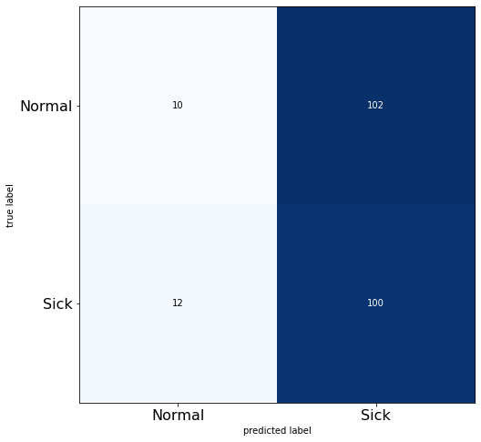
Unknown Dataset 2
Total number of test examples: 224
Input size: 224, 224
Color Channels: 3
Total number of labels: (224, 2)
Loss on test set: 4.513689041137695
Accuracy on test set: 0.4910714328289032
Recall of the model is 0.89
Precision of the model is 0.50

Slide 19
Challenges Encountered
Challenge of overfitting with changing batch size
Model loss still high
Computing Resources to run model

